Slide 1


FACULTY OF INFORMATION TECHNOLOGY
WannaHide

Slide 2
Presented by
Mahmoud Mohammed, Abdullah Riad, Fouad Mostafa, Abdulrahman Fathy
Supervised by
Prof. Dr. Rania Elgohary

Slide 3

Agenda
Introduction
Possible Beneficiaries
Motivation
Main Objectives
SDG’s Goal
Related Works
Problem Definition
Proposed System
System Architecture
Methodologies and Techniques
System Requirements (S/W and H/W Tools)
Results and Outcomes
System Validation
Conclusion
References

Slide 4

Introduction

Slide 5
Possible Beneficiaries
General Users
Journalists
Government Agencies

Slide 6

Motivation

Slide 7
Main Objectives
End-to-End Encryption
Secure communication channel
Private communication channel

Slide 8

SDG’s Goal
Goal 16: Peace, Justice, and Strong Institutions:
End-to-end encryption enhances user privacy and security, protecting against unauthorized access and surveillance. This contributes to building trust and ensuring secure communication channels.

Slide 9



Related Works

Slide 10



Problem Definition
Hello
Hello

Slide 11
Proposed System
@#$!
Hello

Slide 12
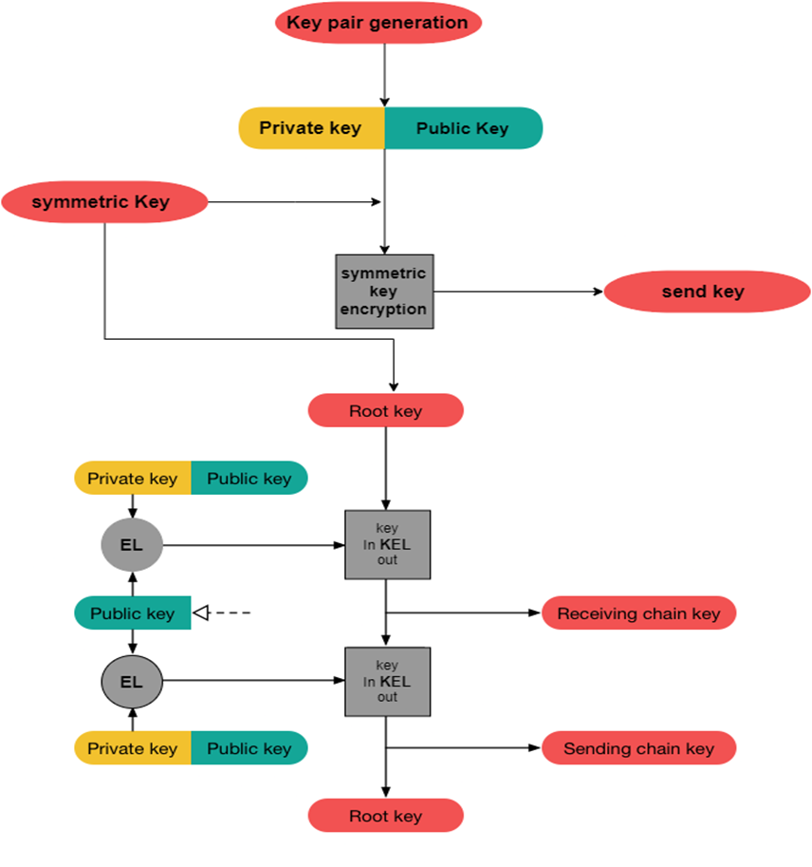
Proposed System

Slide 13
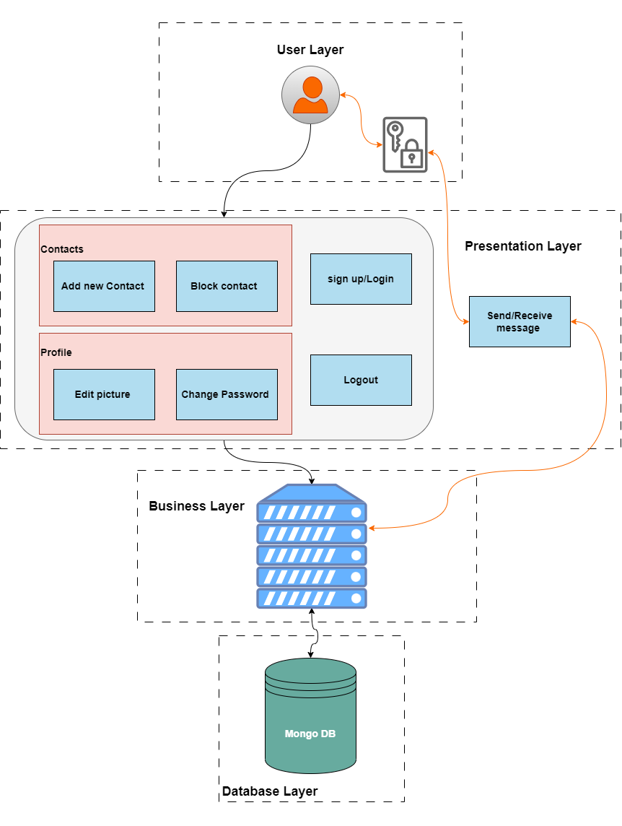
System Architecture

Slide 14


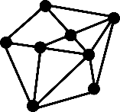



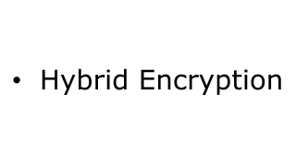

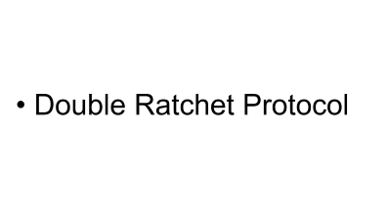
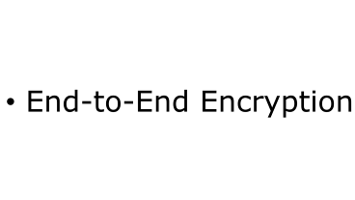
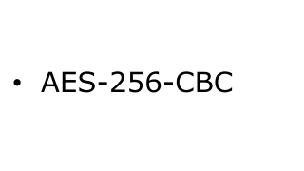
Methodologies and Techniques

Slide 15
End-to-End Encryption

Slide 16

End-to-End Encryption

Slide 17
EL Gamal Encryption

Slide 18
El Gamal Encryption
Key Generation
Choose a large prime number p and a generator g of the multiplicative group of integers modulo p.
Choose a random secret number a, such that 1 < a < p - 1.
Compute A = g^a mod p and publish (p, g, A) as the public key. Keep a as the private key.
Encryption
Decryption
Choose a random secret number k, such that 1 < k < p - 1
and gcd(k, p - 1) = 1.
Compute B = g^k mod p and C = AM^k mod p.
Send (B, C) as the
Compute D = B^a mod p.
Compute M = CD^-1 mod p.

Slide 19
Hybrid Encryption

Slide 20
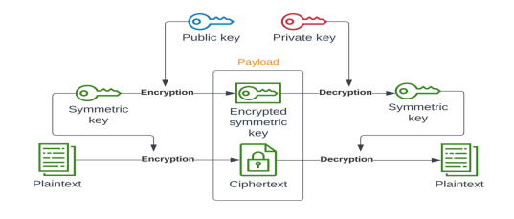
Hybrid Encryption

Slide 21
AES-256-CBC

Slide 22
AES-256-CBC
Decryption
Retrieve the encryption key and IV.
Divide the ciphertext into fixed-size blocks.
Decrypt the first ciphertext block using AES-256 and the encryption key.
XOR the decrypted block with the IV (for the first block)or the previous ciphertext block (for subsequent blocks).
Decrypt the next ciphertext block using AES-256 and the encryption key.
XOR the decrypted block with the previous ciphertext block.
Repeat the XOR and decryption steps for each subsequent block.
Encryption
Generate a 256-bit encryption key.
Generate a random 128-bit initialization vector (IV).
Divide the plaintext into fixed-size blocks (usually 128bits).
XOR (exclusive OR) the first plaintext block with the IV.
Encrypt the XOR result using AES-256 with the encryption key.
XOR the resulting ciphertext block with the next plaintext block.
Encrypt the XOR result using AES-256 with the encryption key.
Repeat the XOR and encryption steps for each subsequent block, using the previous ciphertext block in the XOR operation.

Slide 23
Double Ratchet Protocol

Slide 24
C = E(Sk, E(mk, M))
Sk = RKDF(SS, mk)
mk’ = RKDF(ck, 1)
Sk’ = RKDF(Sk, ck)
mk = E(Sk, E(mk', M'))
Double Ratchet

Slide 25




System Requirements (S/W and H/W Tools)

Slide 26

Results and Outcomes

Slide 27

Results and Outcomes

Slide 28


Results and Outcomes

Slide 29
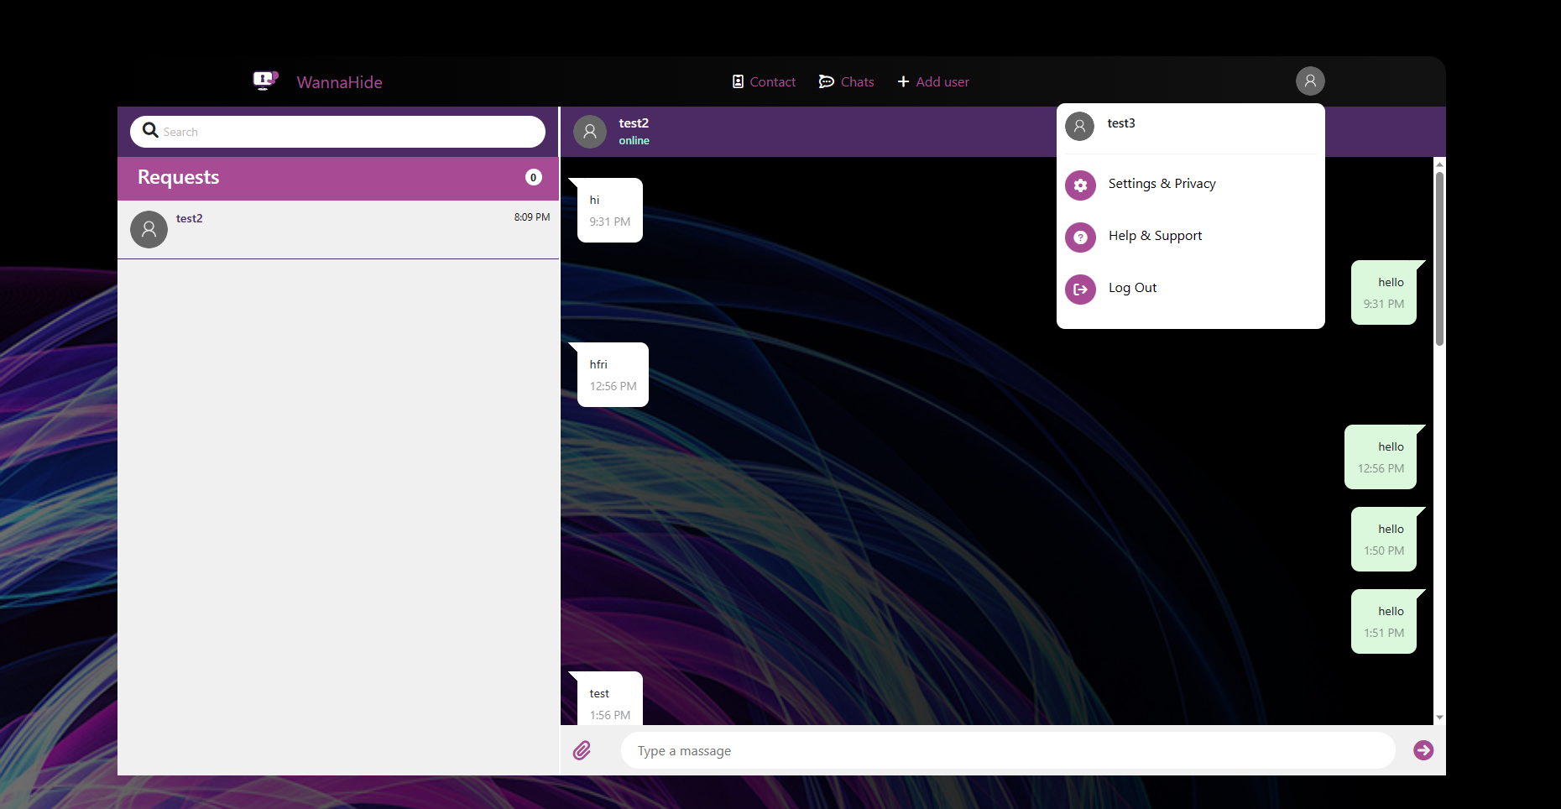
Results and Outcomes

Slide 30
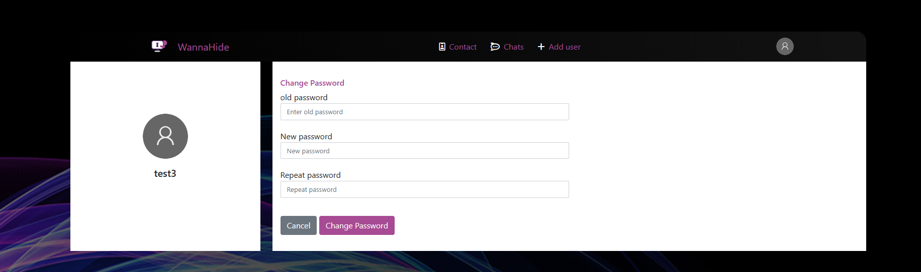
Results and Outcomes

Slide 31

System Validation

Slide 32

Conclusion
El-gamal Algorithm has proven to be more secure than Diffie-hellman
Diffie-hellman consumes less time in encryption process
El-gamal algorithm is generally slower compared to symmetric encryption algorithms due to its reliance on complex mathematical operation

Slide 33
References
Oleiwi, Z. C., Abdallah, W., & Alisawi, W. C. (2023, june 27). publication/342521740_Overview_and_Performance_Analysis_of_Encryption_Algorithms. Retrieved from researchgate: https://www.researchgate.net/publication/342521740_Overview_and_Performance_Analysis_of_Encryption_Algorithms
Ringcentral Corporate. (2023, March 31). Introducing dynamic end-to-end encryption for RingCentral Video. Retrieved from ringcentral: https://www.ringcentral.com/us/en/blog/dynamic-end-to-end-encryption/
Alisawi, W. C., Oleiwi, Z. C., Alawsi, W. A., Alfoudi, A. S., & Hadi, N. K. (2019). Improvement of classical cipher algorithm based on a new model of timed-released encryption. International Journal of Applied Engineering Research, 14(16), 3531-3536.
Dechand, S., Naiakshina, A., Danilova, A., & Smith, M. (2019, June). In encryption we don’t trust: The effect of end-to-end encryption to the masses on user perception. In 2019 IEEE European Symposium on Security and Privacy (EuroS&P) (pp. 401-415). IEEE
Wu, J., & Zappala, D. (2018, August). When is a Tree Really a Truck? Exploring Mental Models of Encryption. In SOUPS@ USENIX Security Symposium (pp. 395-409).

Slide 34


